Slide 1

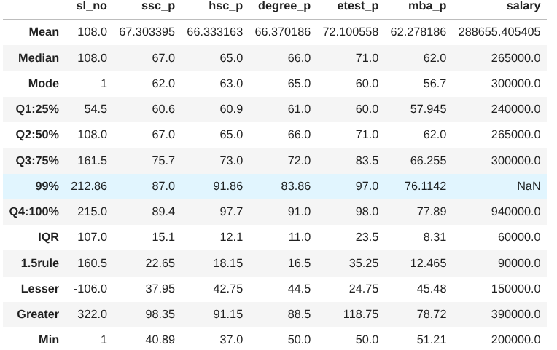
Data Science
Percentile Assignment

Slide 2
(ssc_p)%
Min (40.89): Lowest ssc_p% is 40.89%
25% : 25% of students scored below 60.6%.
50% (Median = 67): Half of the students scored below 67%.
75%: 75% of students scored below 75.7%
100% (Max = 89.4): Highest ssc_p% is 89.4%.
(hsc_p)%
Min (37): Lowest hsc_p% is 37.
25%: 25% students scored below 60.9%.
50%: Half of the students scored below 65%.
75%: 75% of students scored below 73%.
100% (Max = 97.7): Highest hsc_p% is 97.7.

Slide 3
(degree_p)%
Min (37): Lowest degree_p% is 50.
25% : 25% scored below 61.
50% : Half of the students (Median) scored below 66%.
75% : 75% scored below 72.
100% (Max = 91): Highest degree_p% is 91.
(mba_p)%
Min (51.2): Lowest mba_p% is 51.2.
25% : 25% scored below 57.945.
50% : Half of the students (Median) scored below 62%.
75% : 75% scored below 66.255.
100% (Max = 77.9): Highest mba_p% is 77.9.

Slide 4
(etest_p)%
Min (50): Lowest employability test score is 50.
25% : 25% scored below 60.
50% : Half of the students (Median) scored below 71.
75% : 75% scored below 83.5.
100% (Max = 98): Highest test score is 98.
Salary
Min : Lowest salary is ₹2,00,000.
25% : 25% salaries are below ₹2,40,000.
50% : Median salary is ₹2,65,000.
75% : 75% salaries are below ₹3,00,000.
100% (Max = 940000): Highest salary is ₹9,40,00

